Slide 1
Introduction to Onshape
Notes:
alex

Slide 2
What does CAD stand for?
Computer Assisted Disciplines
Computer Aided Design
Camels and Deserts
Computational Advertising Design
Type in the chat or say it out loud!
Notes:
alex

Slide 3
Answer:
b. Computer Aided Design
Notes:
alex

Slide 4
Signing up for Onshape
Go here!
https://www.onshape.com/en/education/#form-container
Create an account and go through the steps (anyone willing to screenshare to show us?)
Send us all your emails here (so we can add you to the team)!!
https://forms.gle/G5feXKMFnmrUggUN8
Notes:
Alex
Maya splits off to do CAD help

Slide 5
Agenda
5 mins - ice Breakers + explaining CAD
15 mins - explaining sketching
10 mins - sketching exploration
10 mins - sketch challenge
5 min - creating a plane
10 mins - explaining extruding
10 mins - extruding challenge
15 mins - pick a function!
Notes:
Sketching activity: 5:20
Sketch exploration: 5:30
Sketch Challenge: 5:40
Creating a plane: 5:45
Extrude regular: 5:55
Extrude challenge: 6:05

Slide 6
We use CAD to model and simulate our fuselage.
We use Fusion 360 currently, but today we’ll be teaching you Onshape (it’s much simpler).
Notes:
alex

Slide 7
Getting Started
Because you need to. That should be obvious, right?

Slide 8
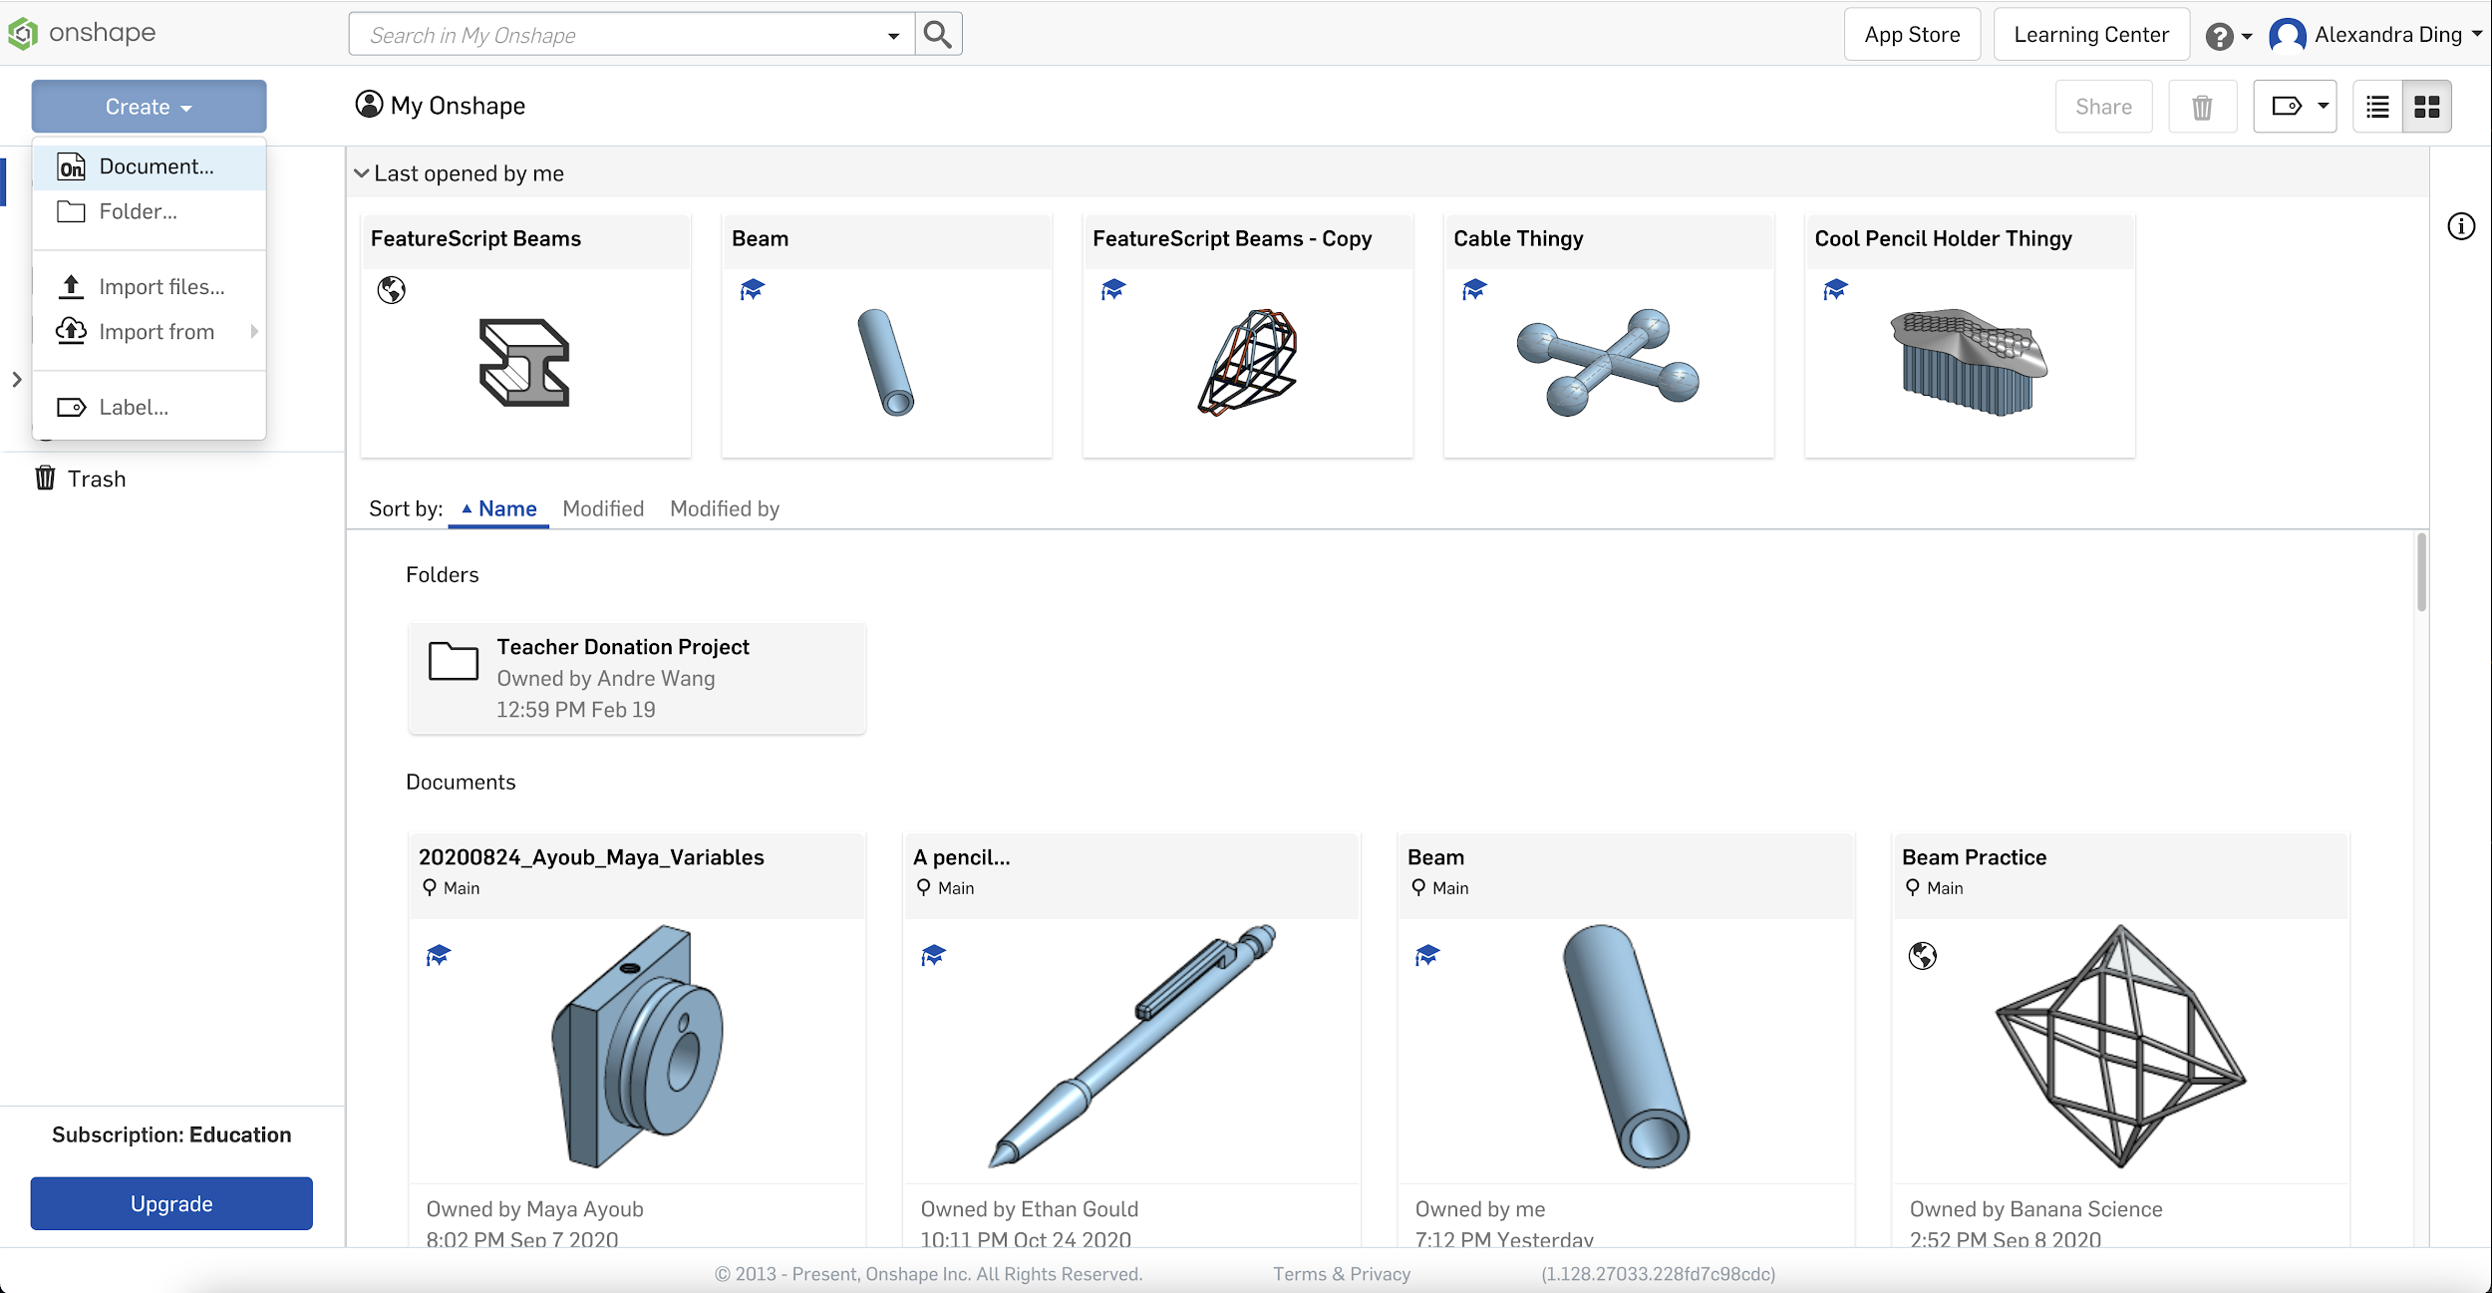
Go to https://cad.onshape.com/
Create a new document (name it anything)!
Notes:
maya

Slide 9
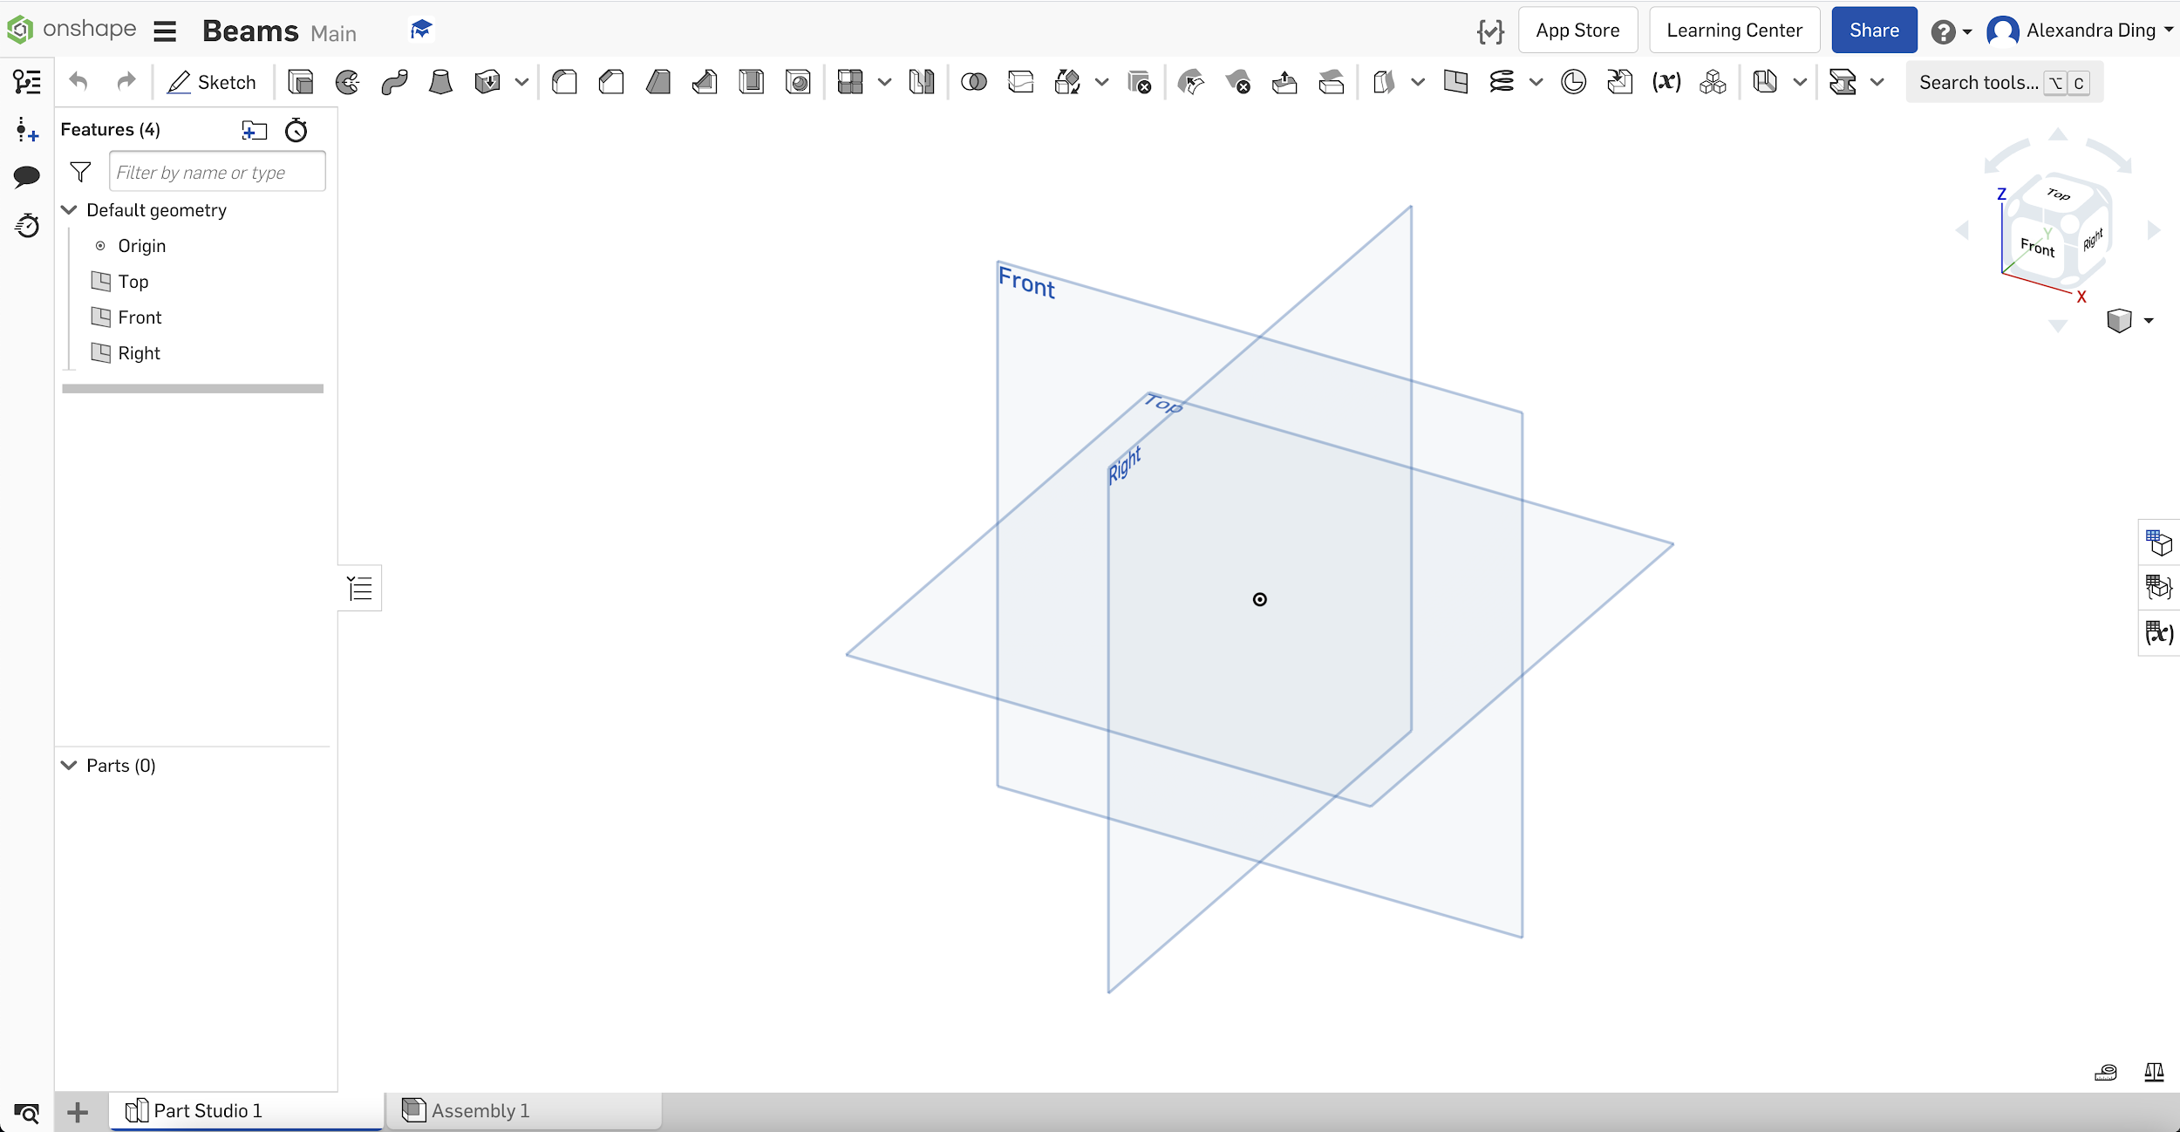
You should see this.
Notes:
maya

Slide 10
If there are any problems, let us know now. We’ll get it fixed.
Notes:
maya

Slide 11
Sketching
This is the basis of everything.

Slide 12
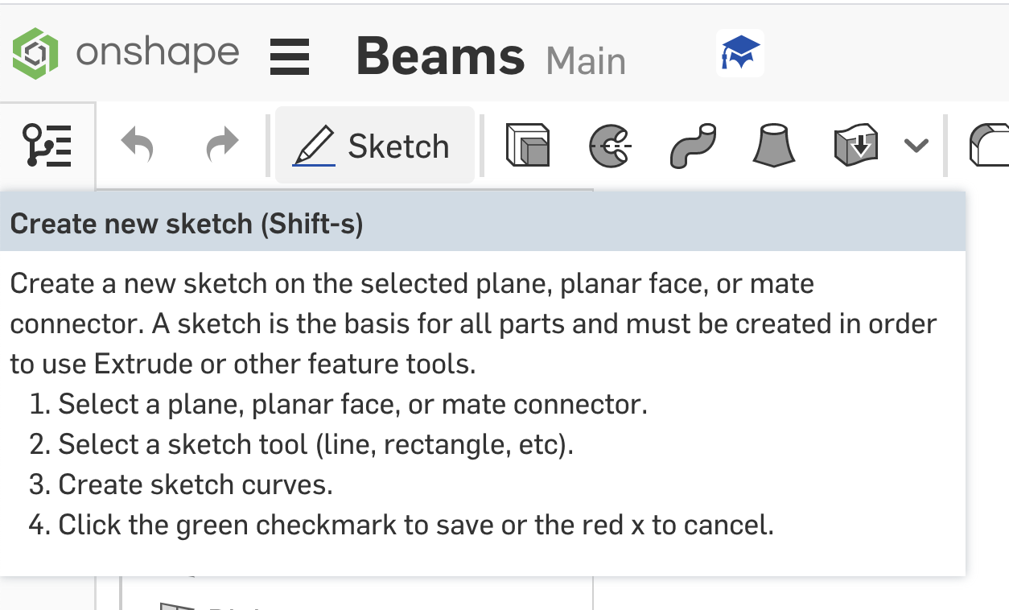
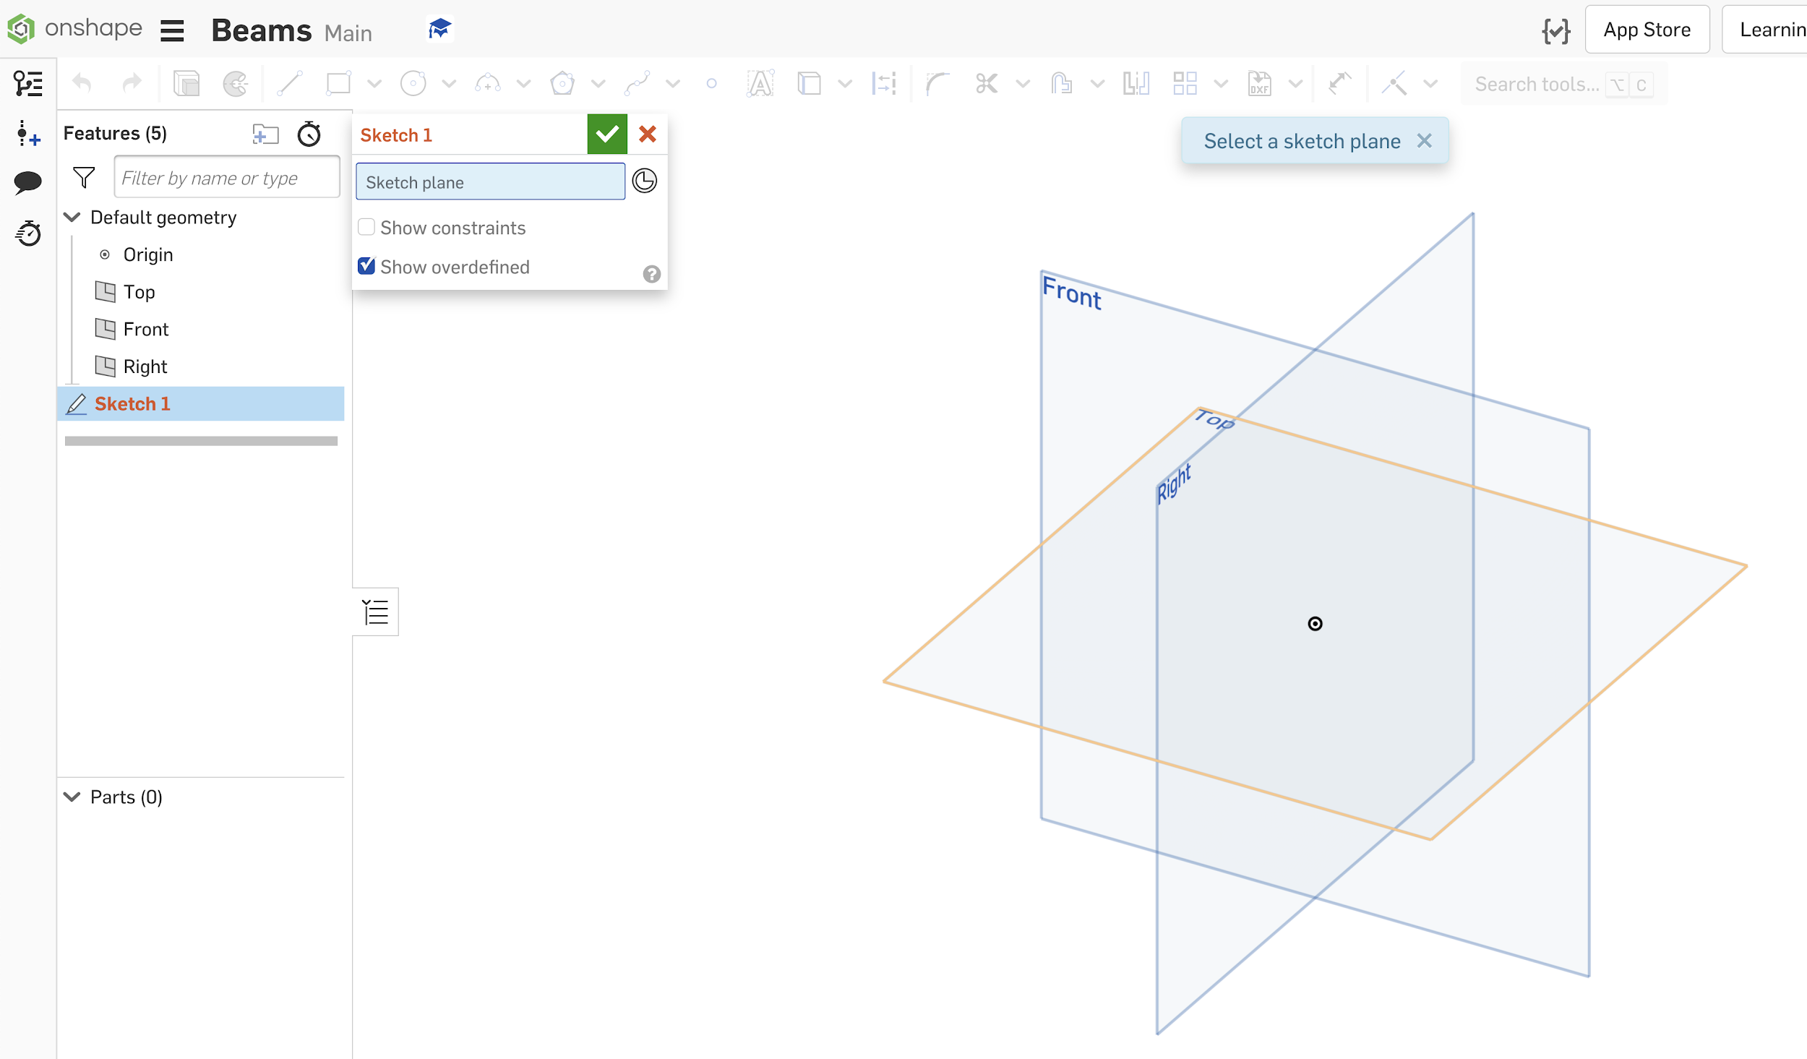
Starting a Sketch
Create a Sketch
Click on a plane to select a sketch plane

Slide 13
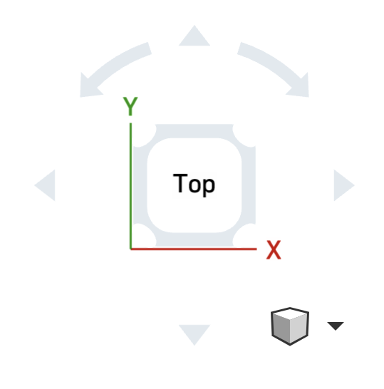
Navigating
Pan/rotate/zoom using the cube in the top right corner or right click/mouse scroll.

Slide 14
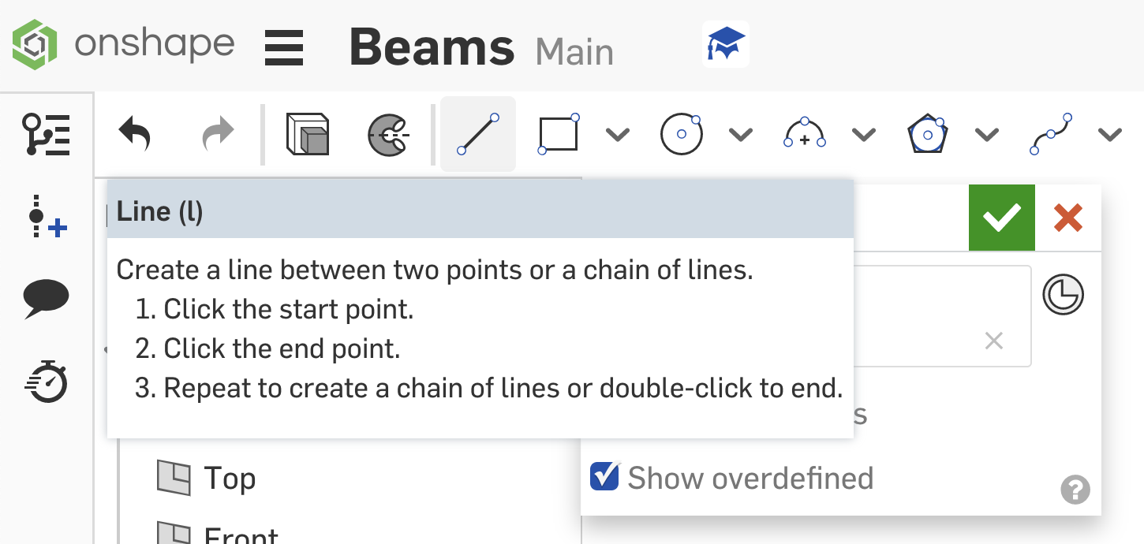
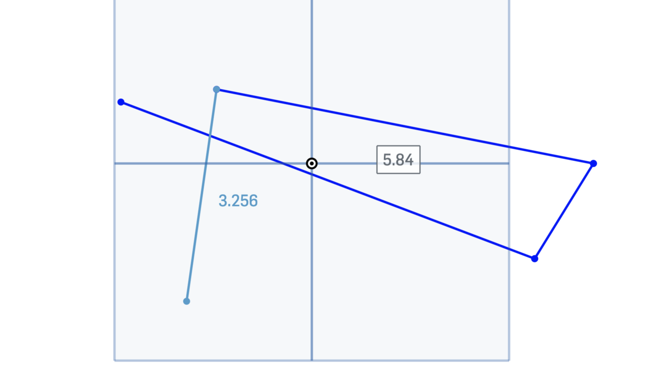
Lines
Click on the line icon or press l (keyboard shortcut!)
Click! And click… and click…
You can also click and hold
To escape the line: right click → escape line, or reclick the icon / press l

Slide 15
Did something wrong? You can control + z it away (you probably know this already, I hope).

Slide 16
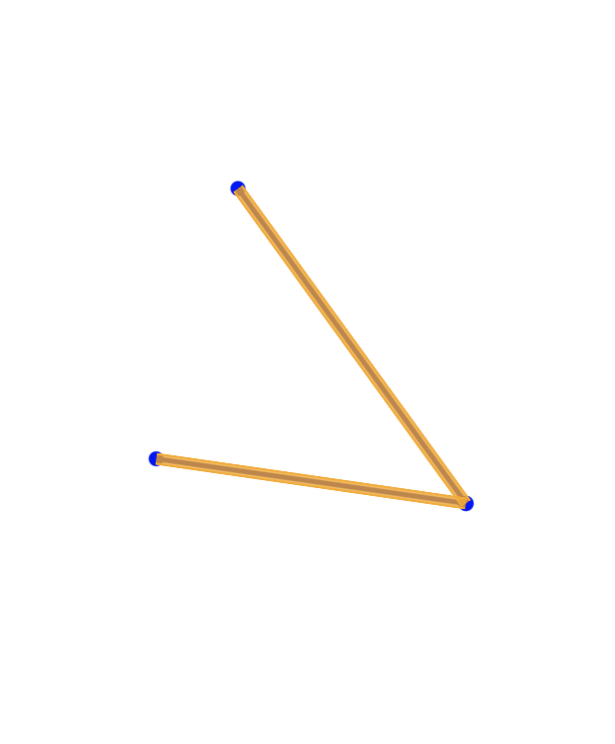
You can always highlight (click and hold over the area) + delete

Slide 17
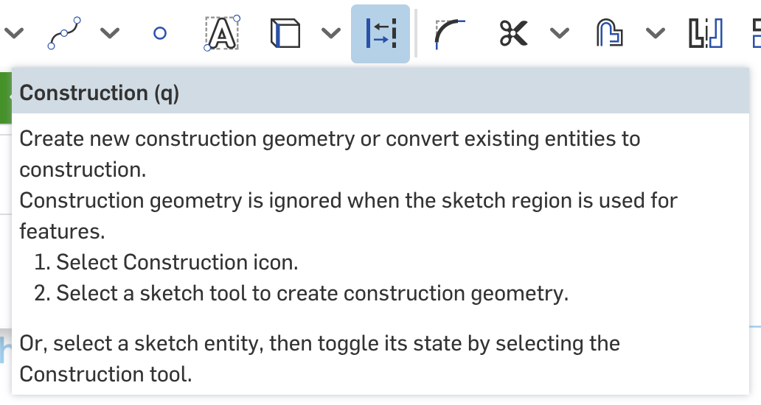
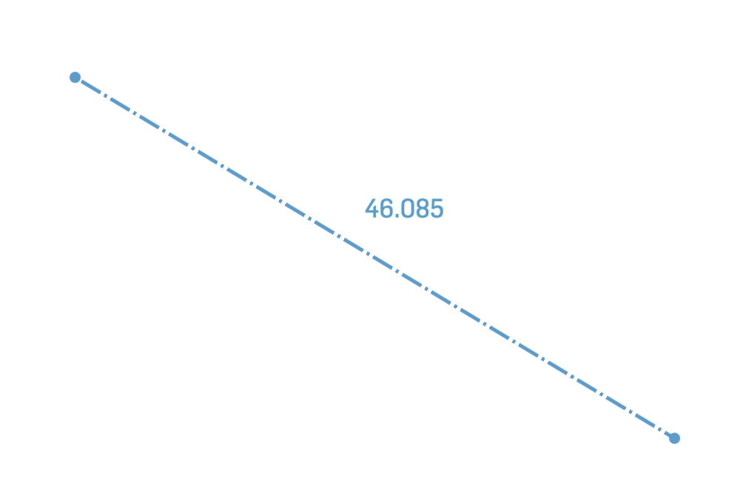
Construction
Constructions are reference lines.
Click the icon or press q
Draw a line or anything else you want to be a construction
A construction will act just like a normal line, except you won’t be able to extrude it later on (more on that later).

Slide 18
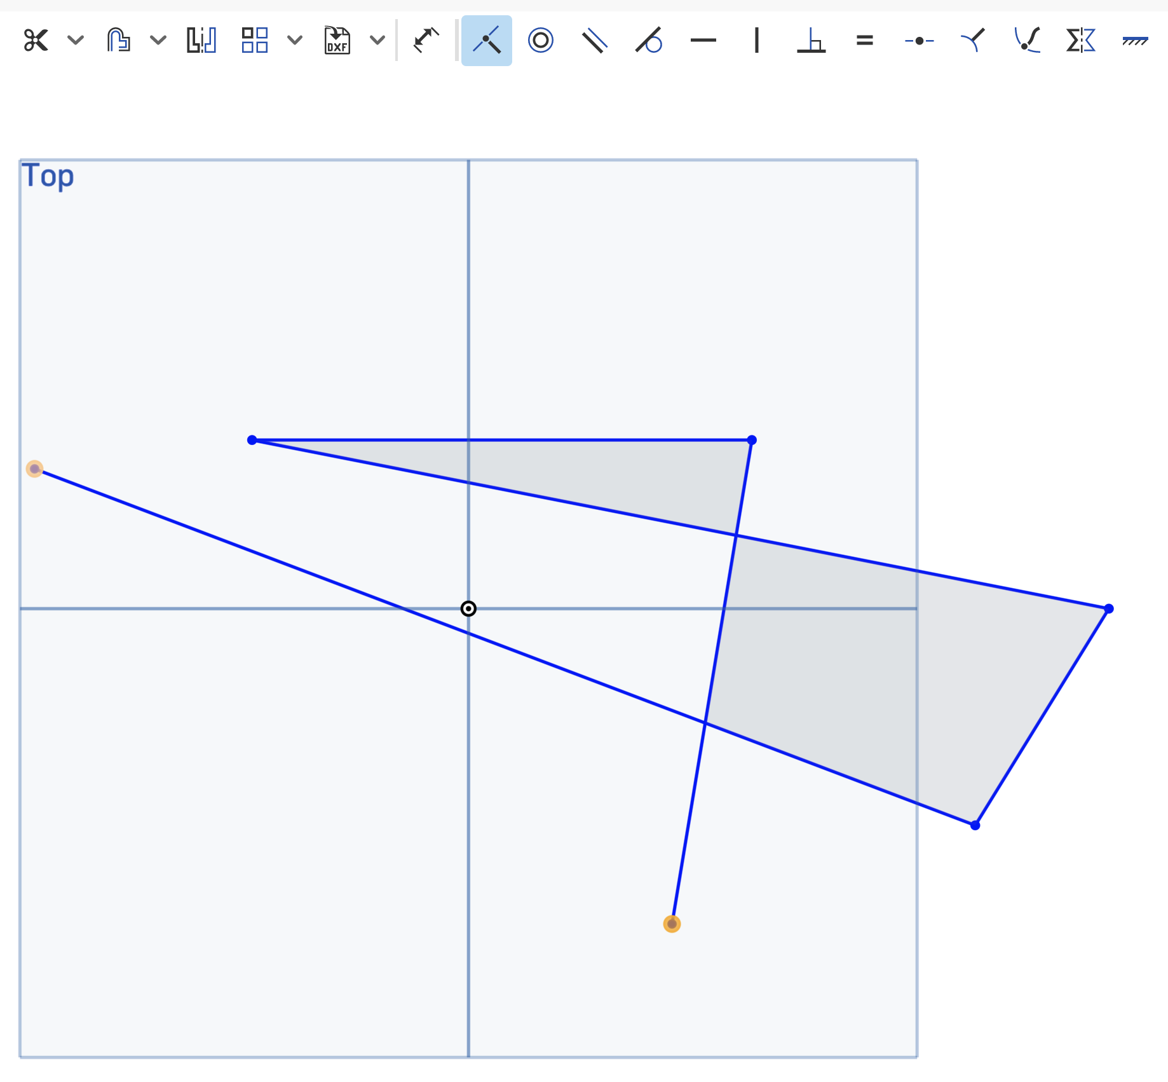
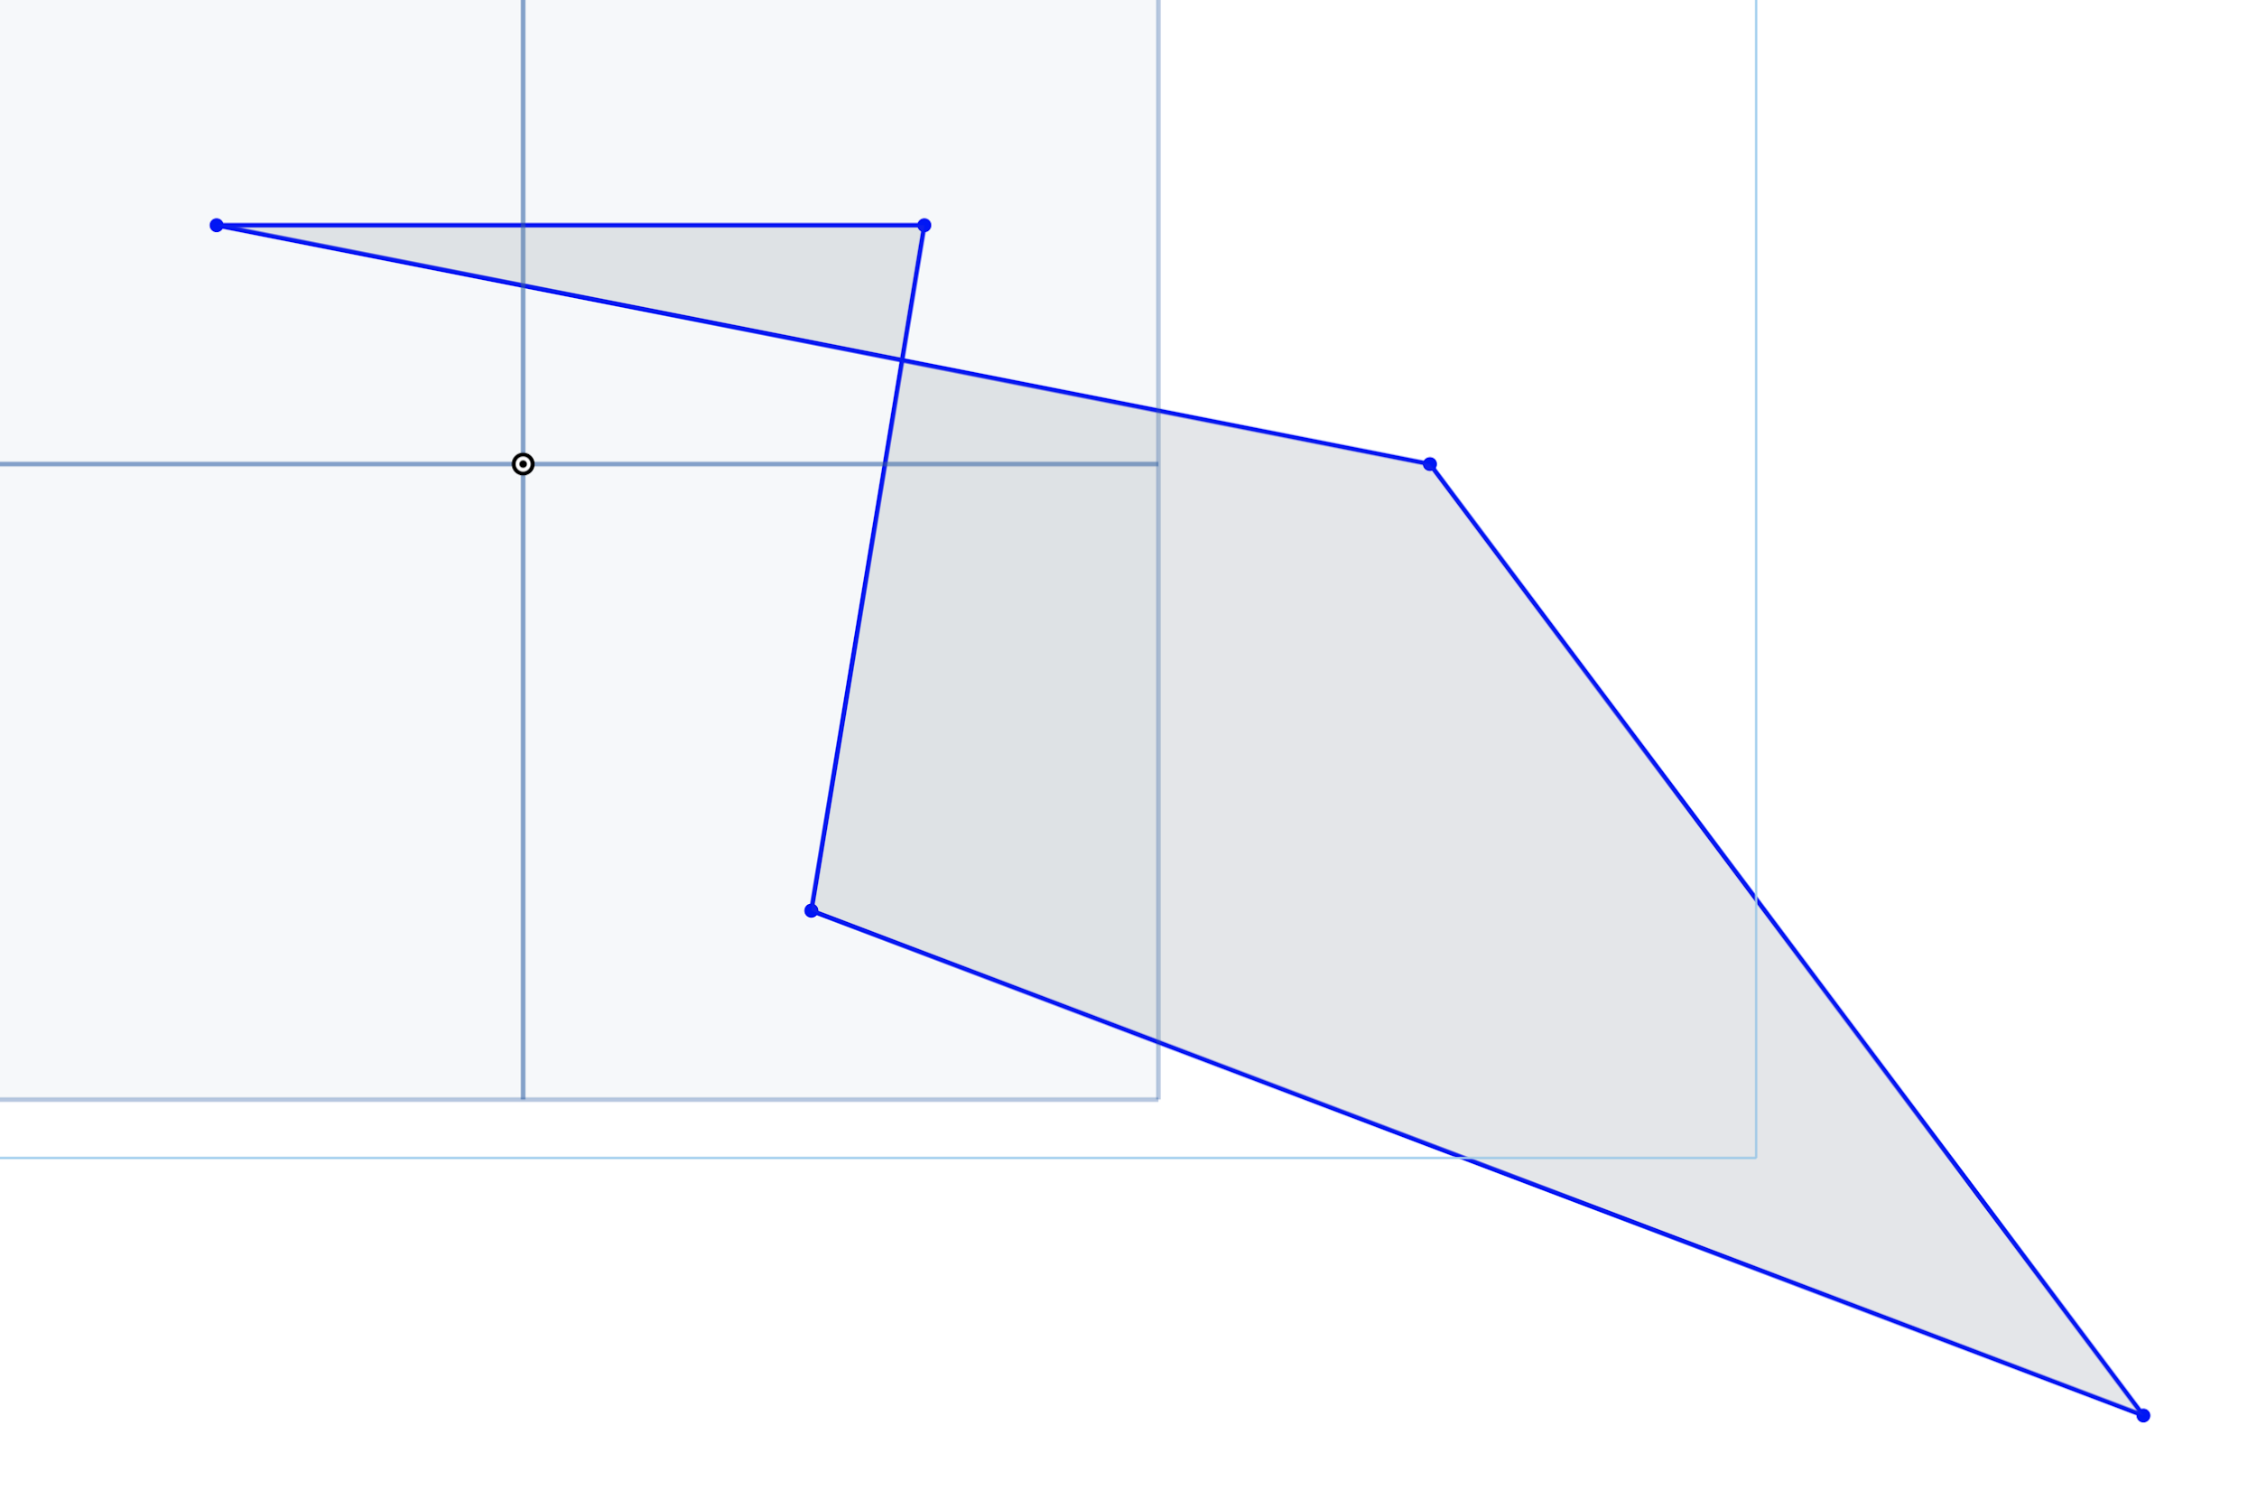
Constraints
They’re next to the search bar. (Yes, there are a lot).
Coincident — makes sure two things are touching
Click on the coincident icon (or press the i key)
Click the two things you want to touch
Tada! Constrained!

Slide 19
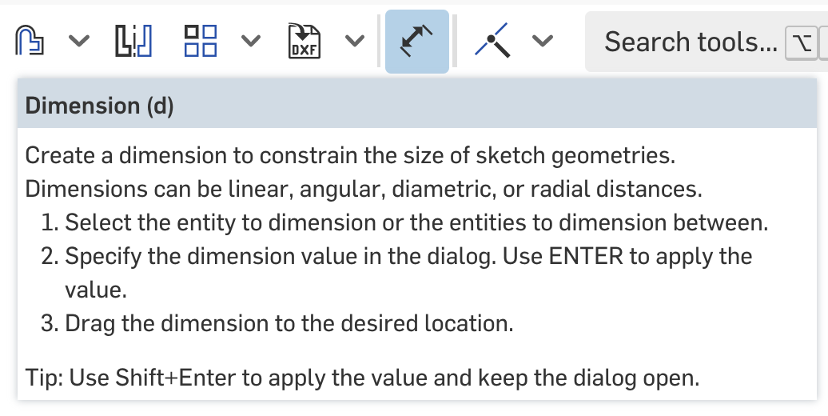
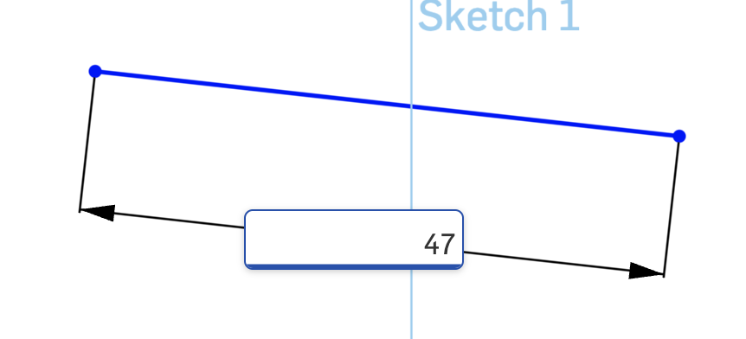
Dimensioning
Click the dimension icon or press d
Click whatever you want to dimension, then enter the size and press enter

Slide 20
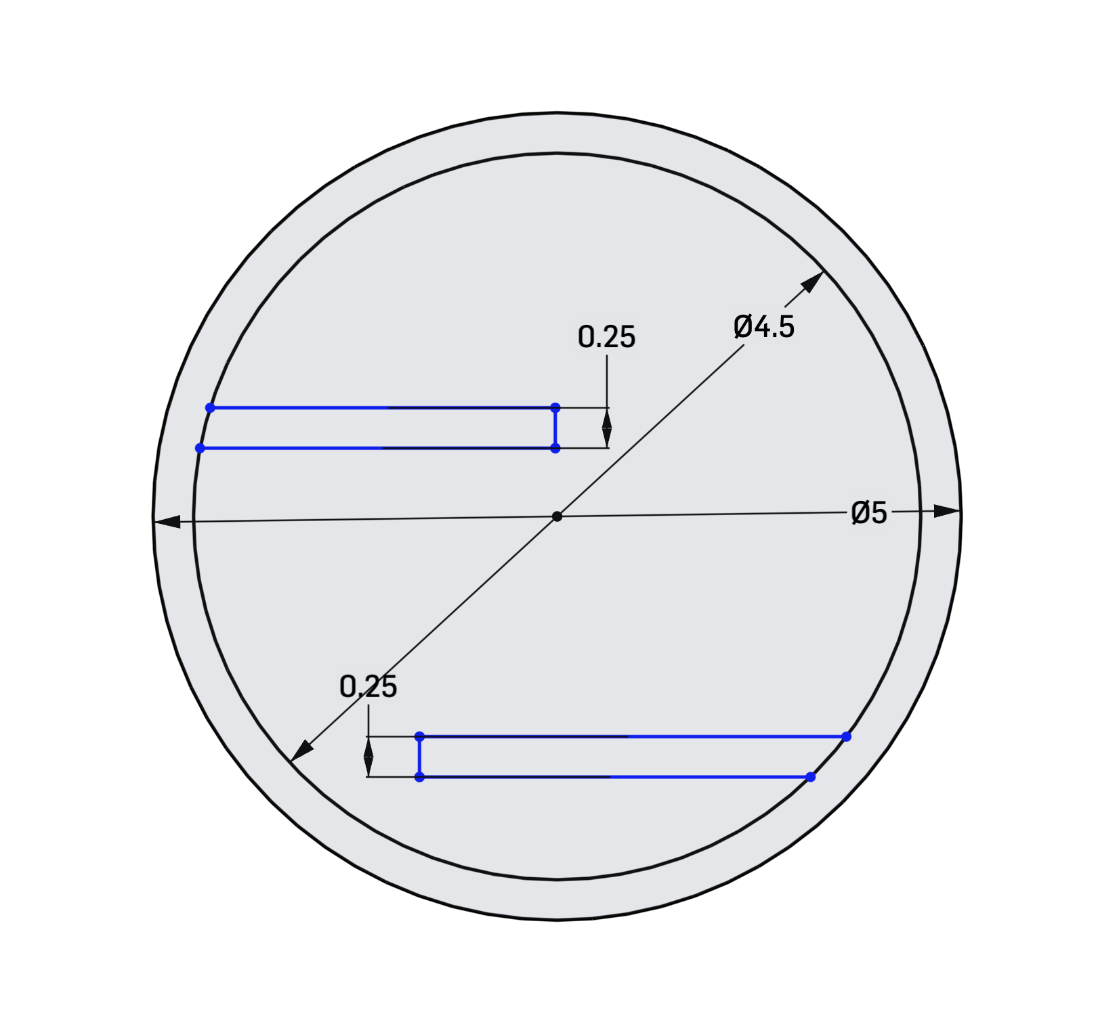
If everything is constrained the sketch should be black.

Slide 21
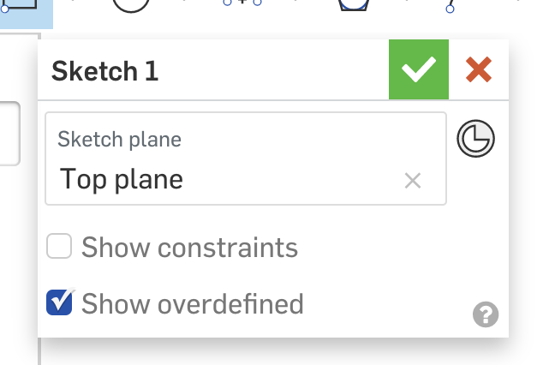
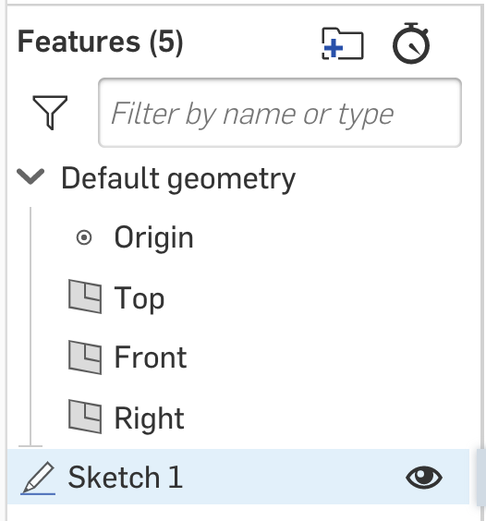
Finishing a Sketch
Click the green check mark. You can always go back by double-clicking the sketch in the sidebar.

Slide 22

You can show/hide things by clicking the eye symbol

Slide 23
5 minutes! Play around with any other constraints or sketch tools!

Slide 24
Anyone find something they would like to share?

Slide 25
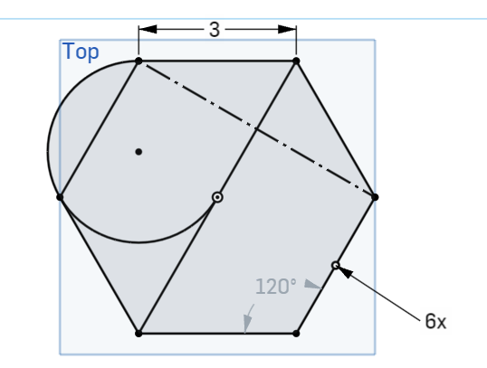
10 minute activity! Try to make this:
Hint: use inscribed polygon tool

Slide 26
Creating a Plane
So you can build off of previous work!

Slide 27
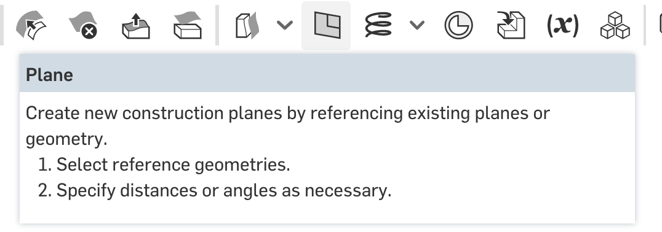
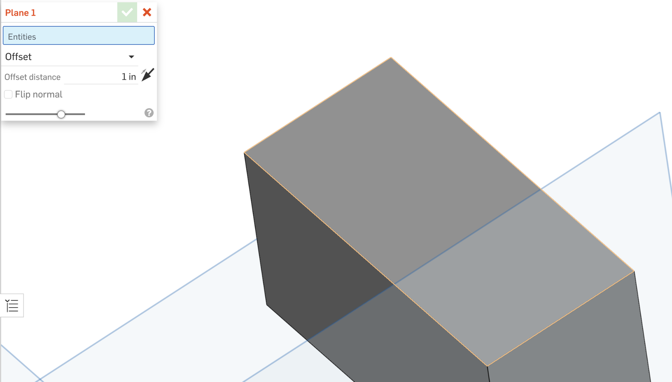
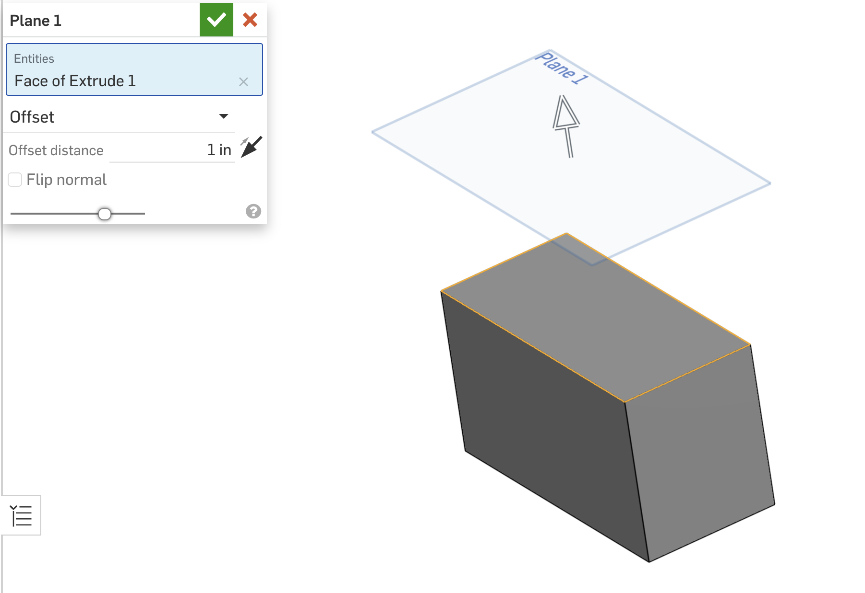
Creating a Plane
Hit the plane button
Click the surface you will build the plane off of
You can adjust offset distance to move the plane up and down.

Slide 28
Extruding
Creating basic 3D shapes

Slide 29
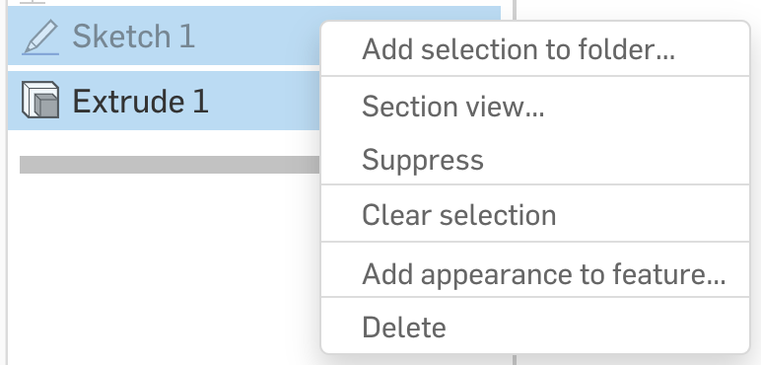
Create a new doc or delete everything.

Slide 30
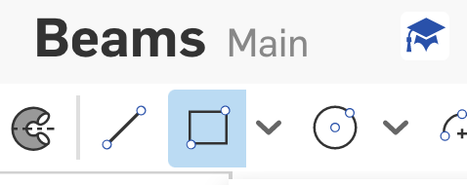
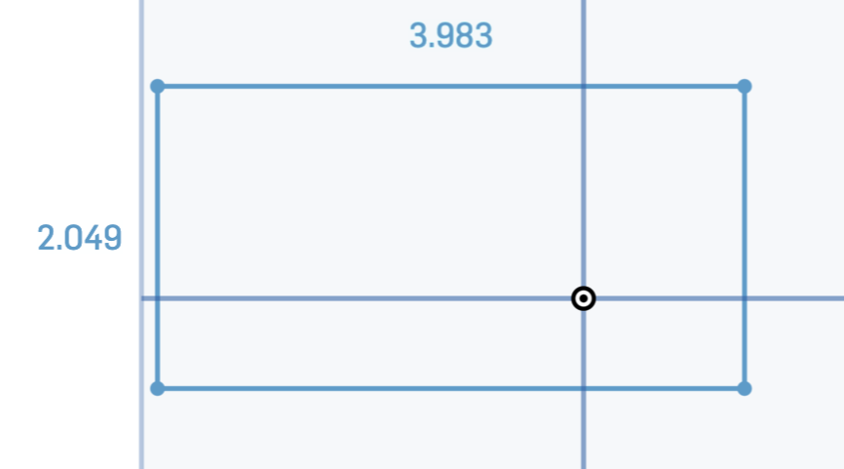
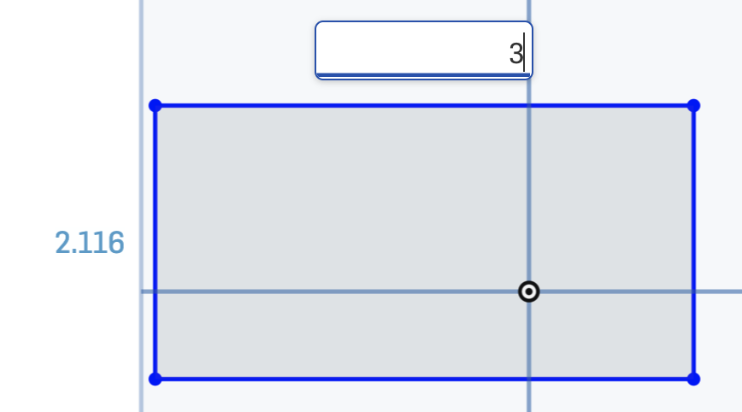
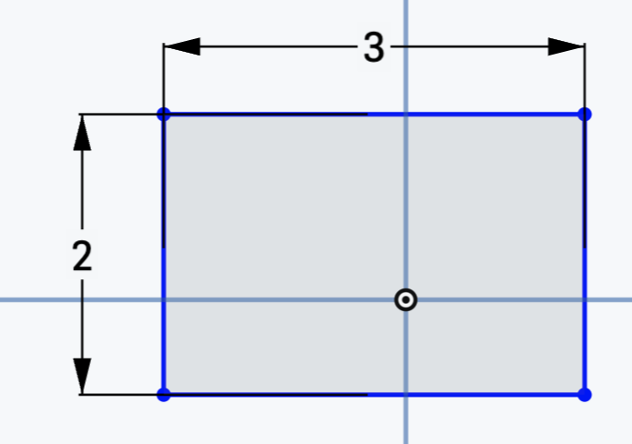
Rectangles
Create a sketch
Draw a rectangle:
Select the rectangle tool, or press the g key
Click for the two corner points
BEFORE CLICKING AWAY: type a number and press enter. The rectangle side will automatically resize. Repeat with the other side
And now your rectangle is dimensioned!
Finish the sketch

Slide 31
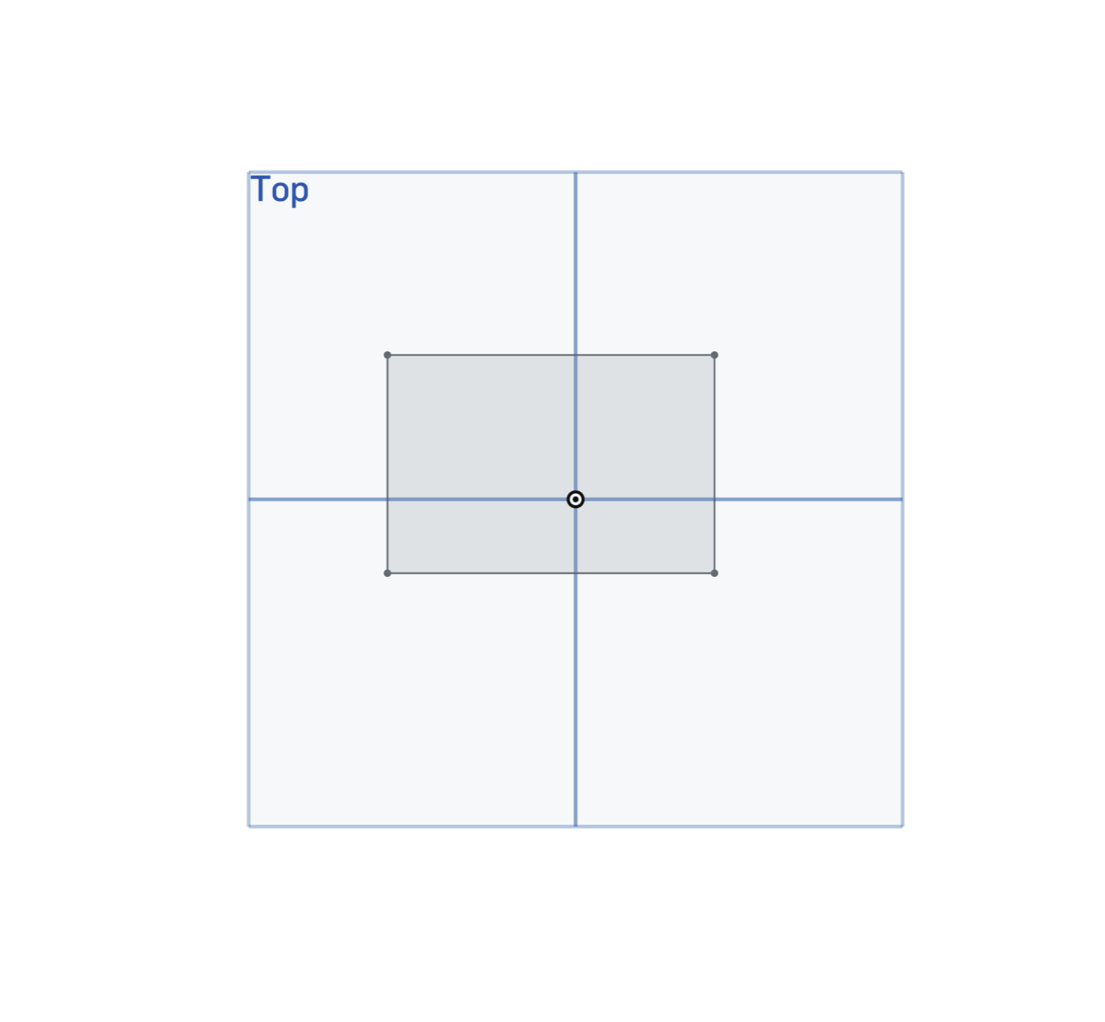
You should see this

Slide 32
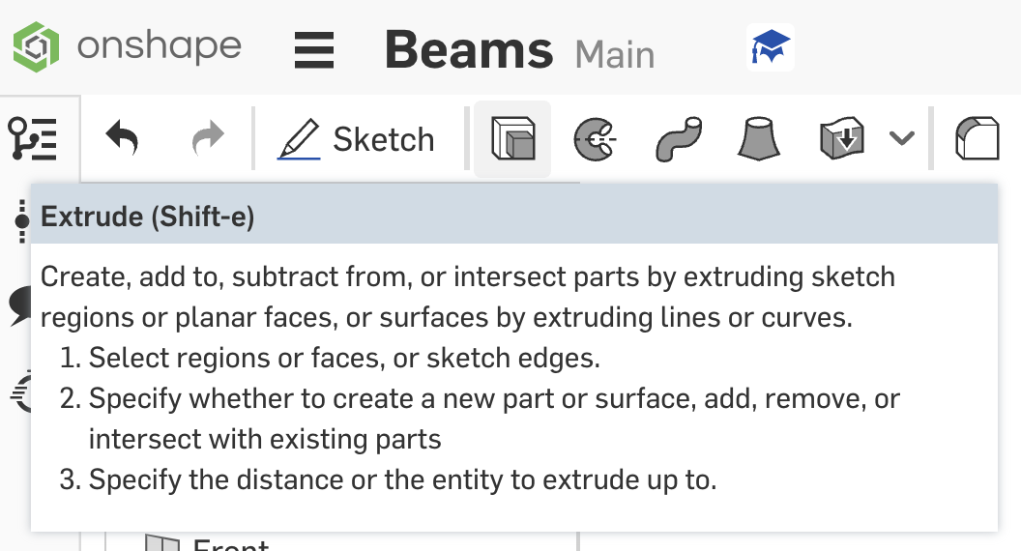
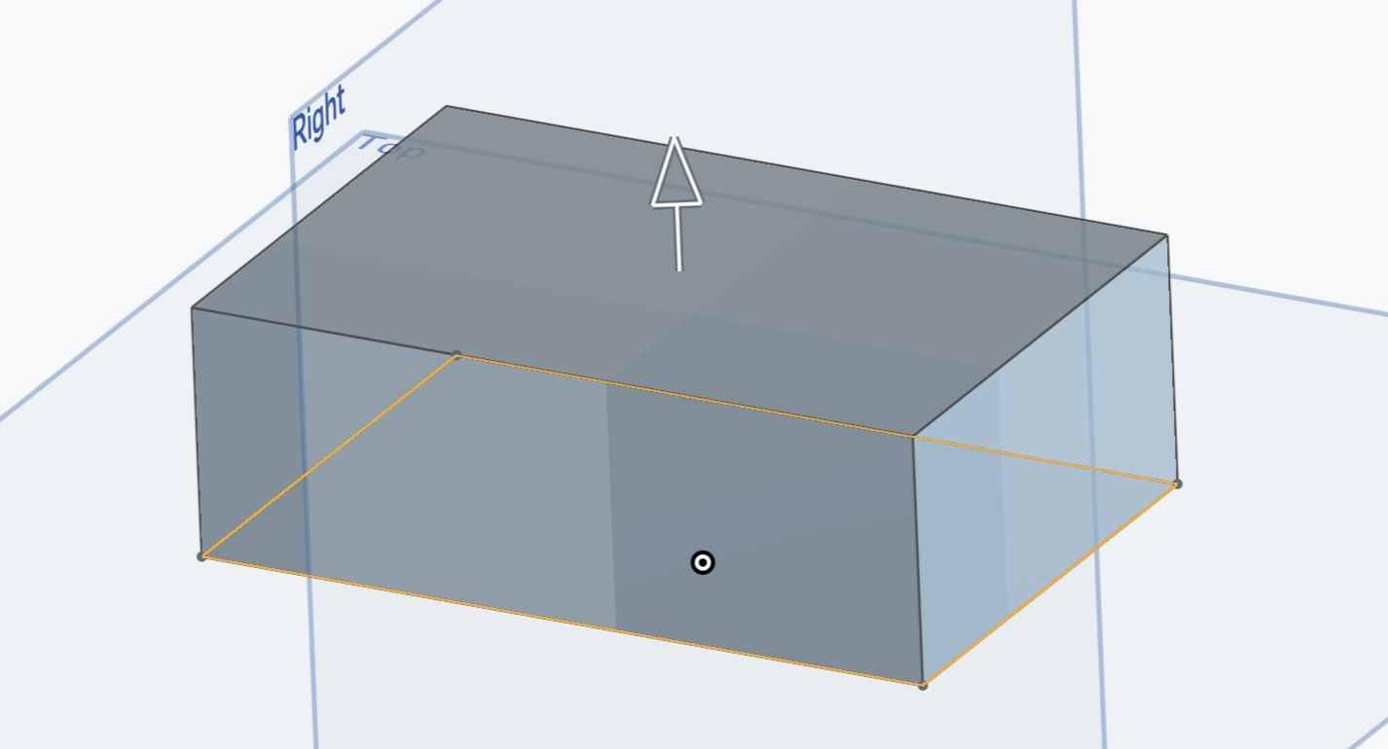
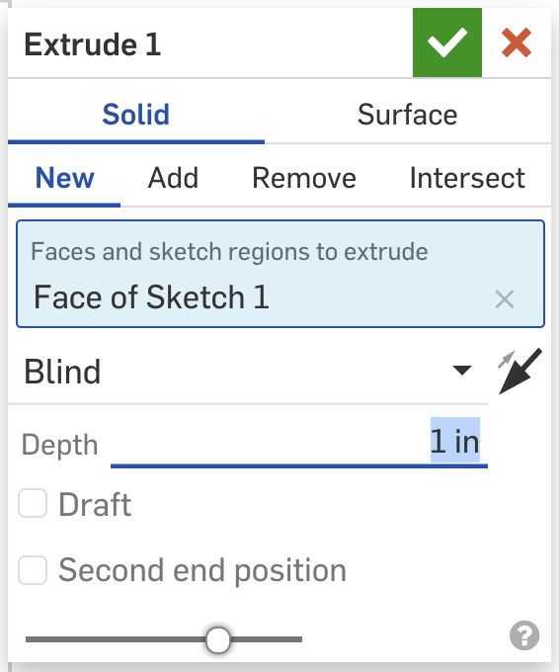
Extruding
Click the extrude button or shift + e
Click the surface you want to extrude (in our case, the rectangle)
You can adjust depth (how tall the extrude will be) in the extrude pop-up window
Once you’re done, click the green checkmark

Slide 33
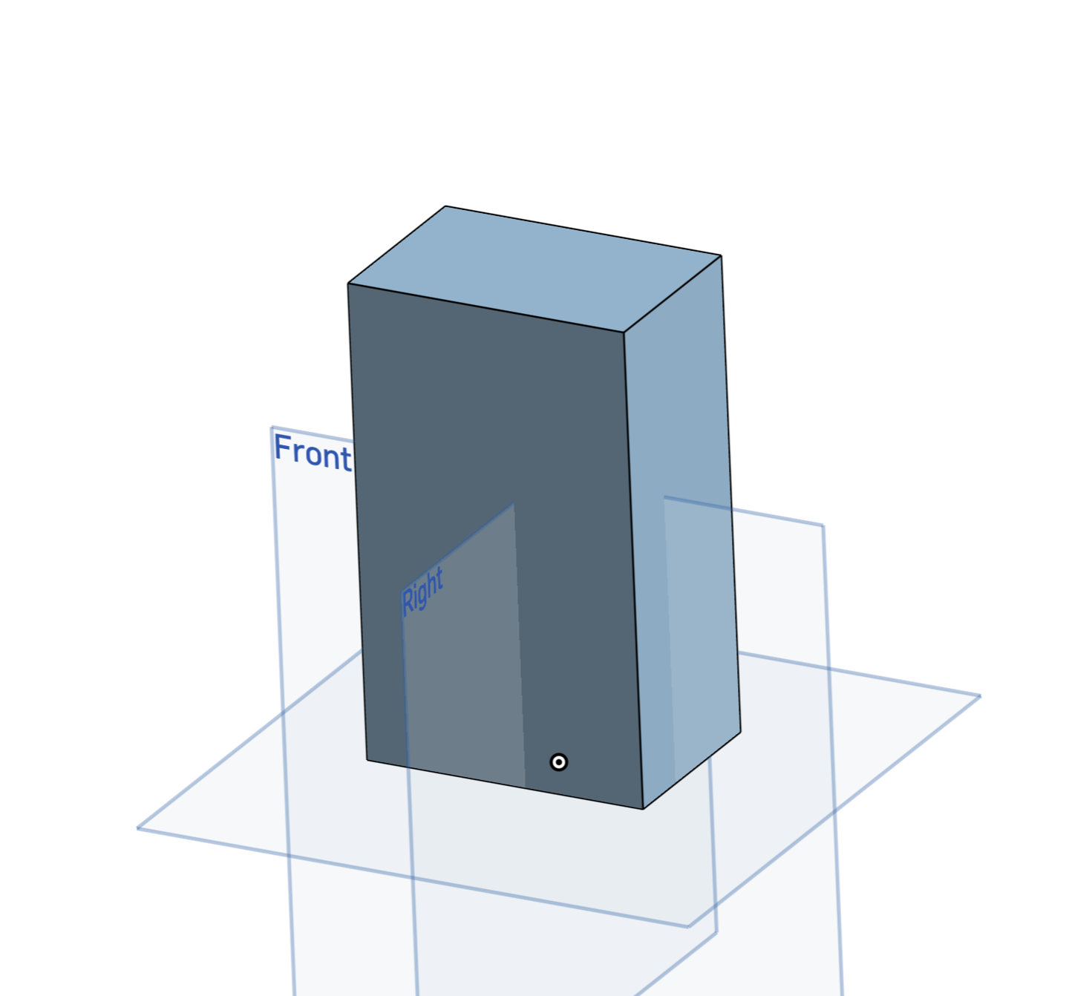
Congratulations! Extrude finished!

Slide 34
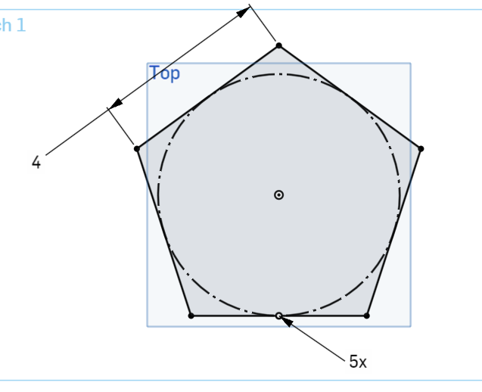
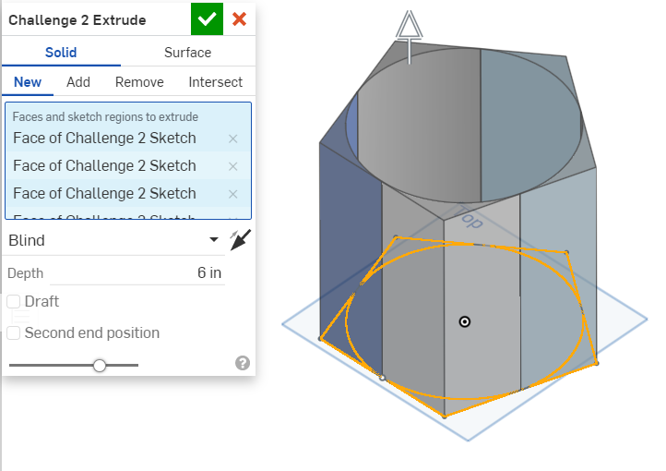
Challenge: Extrude this!
Sketch:
Extrude:

Slide 35
Exploration
It’s time for you to see what else Onshape has to offer!

Slide 36
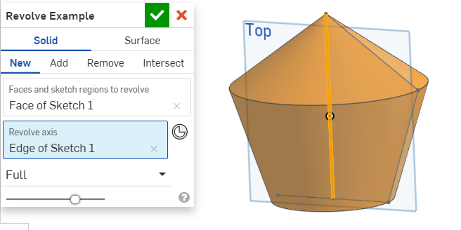
10 minutes: Explore the following
Revolve
Variables
Sweep
Fillet
“Use” tool
Loft
Notes:
Plan: put them in breakout rooms based on what they want to explore
Also have a couple at the bottom for if you need help

Slide 37
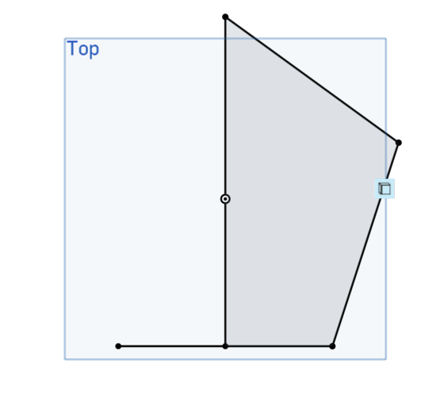
Revolve Sketch
You need a complete profile (make this through a sketch)
All the corners must be coincident.
Make a “revolve axis” → it’s the thing you’re revolving around
It doesn’t need to be attached to anything

Slide 38
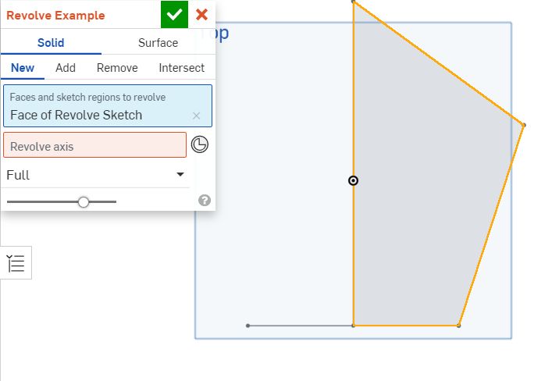
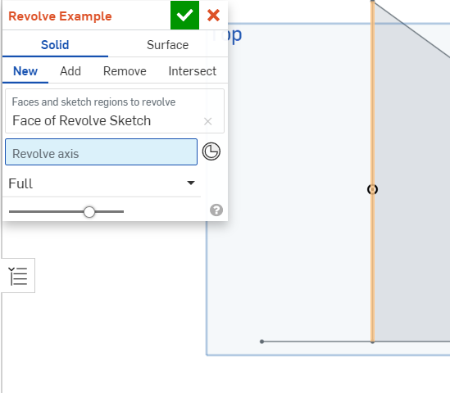
Revolving
1. Select the profile you want to revolve
2. Select the line you want to revolve around

Slide 39
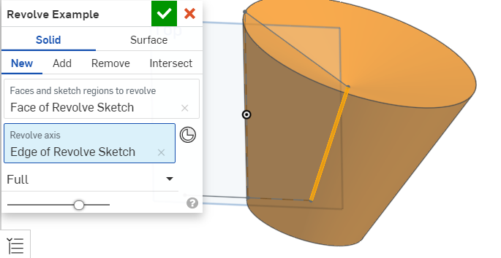
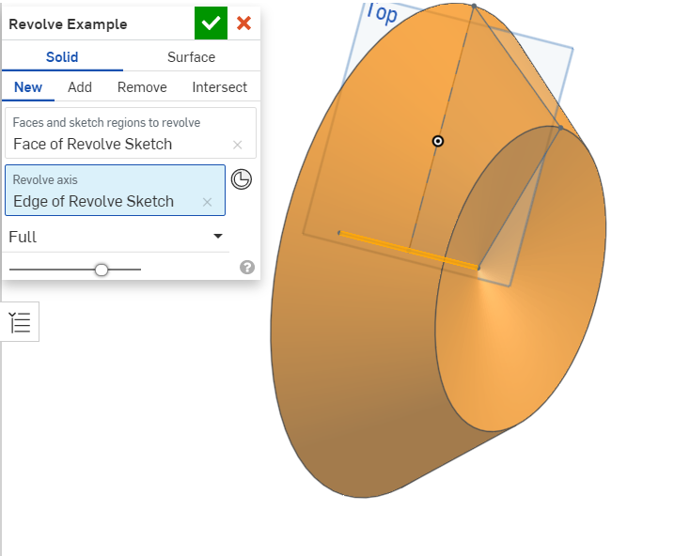
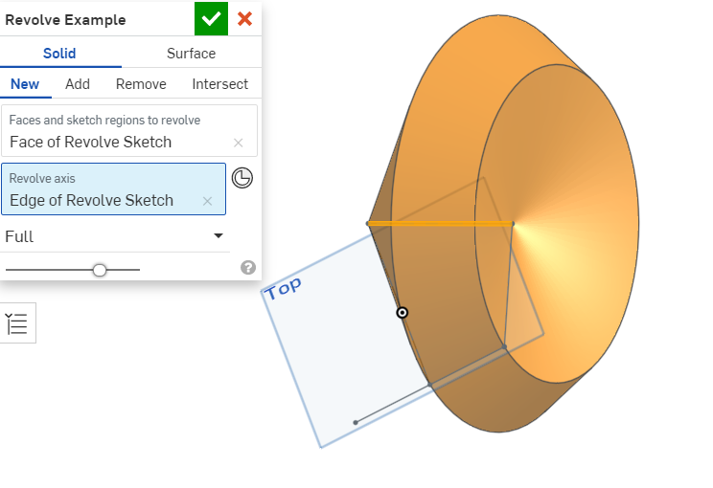
Different Revolve Axises

Slide 40
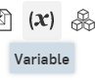
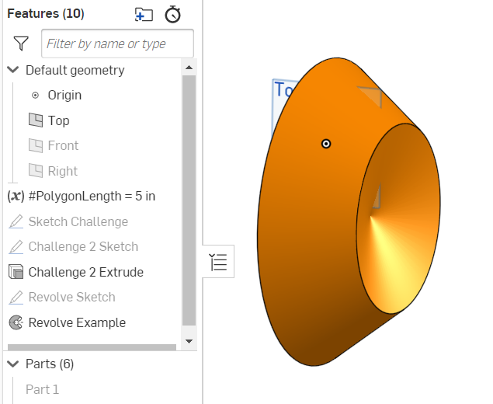
Variables!
Used to:
Change dimensions easy
Create math equations
Create a very specific pattern
In depth video here
How to use it:
Hit the variable button
Name to variable to something and set it to a number
Go into a sketch and dimension something - instead of inputting a number, enter #[the name of your variable]

Slide 41
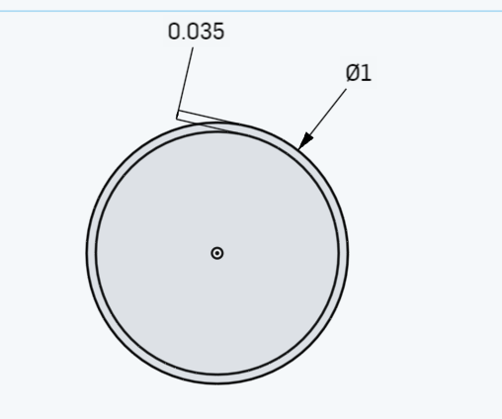
Sweep
Used:
Creating a specific thread
Piping
Creating funky shapes
1. Create a profile on the “top plane”
Name the sketch “sweep profile”

Slide 42
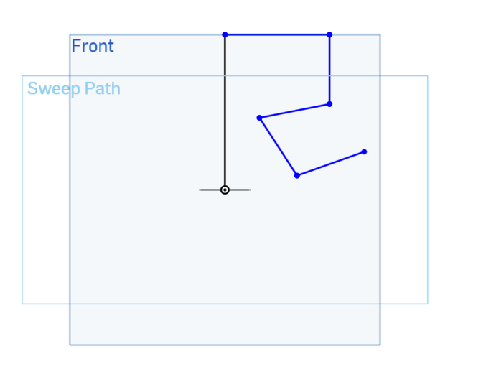
Sweep Path
2. Create a sketch on the “front plane” → Name it Sweep Path
3. Create any path that you want (starting at the origin)
Your profile on the top plane!

Slide 43
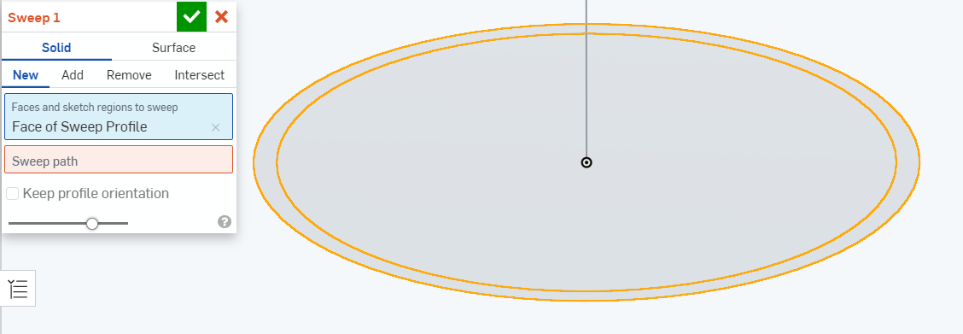
Sweep Tool it!
Hit the tube part of the sweep profile

Slide 44
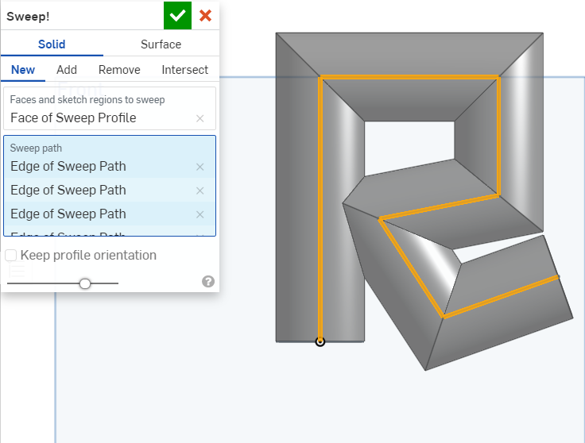
Sweep Tool it!
2. Hit all the individual pieces for the sweep path

Slide 45
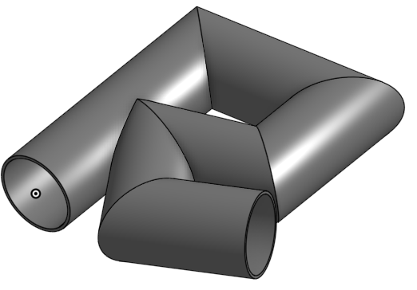
Rotate a bit
There’s your shape!

Slide 46
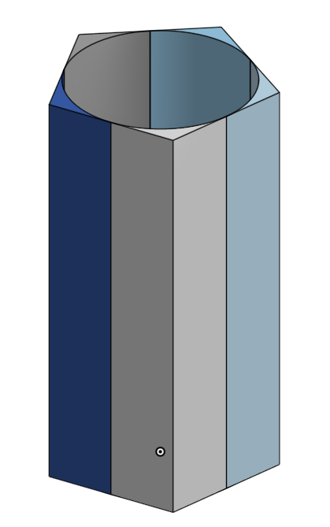
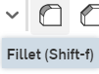
Fillet
Uses:
Most real objects aren’t extremely sharp at the edges
Easy way to make smooth edges
1. Go back to your extrusion challenge from before!
2. Click the fillet tool:

Slide 47
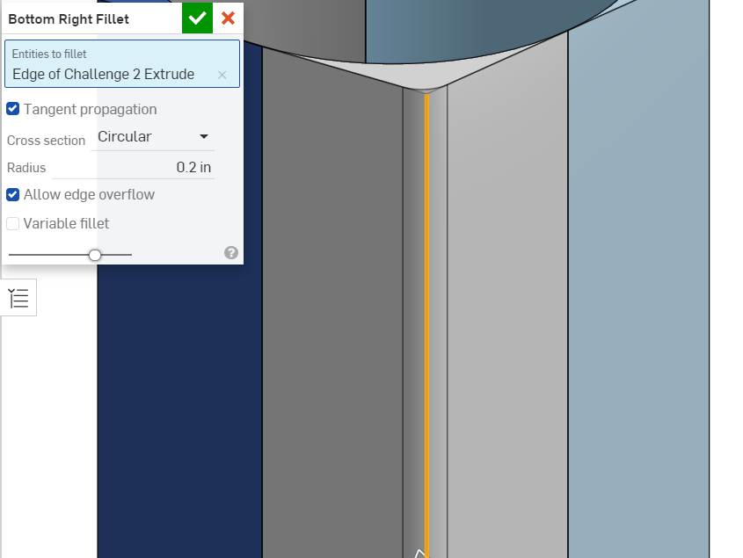
Fillet Tool
3. Select an edge
4. Set what you want the radius to be
You’re done!

Slide 48

Use tool
Uses:
Reference sketches that aren’t directly on the plane you’re working on
Constraining according to old work
Create a sketch on the top of your old extrude

Slide 49


Use Sketch Demo
2. Unhide (click the eyeball) on your sketch challenge
3. Click the use button

Slide 50

Using the Use command
4. Click profiles or lines you want on this new sketch

Slide 51

Revolve with Use
5. Now you can do anything you want with it!

Slide 52

Loft
Create several sketches, each spaced apart one on top of the other (you’ll need to create new planes for each sketch).

Slide 53



Loft
Select the loft tool
Click on your sketches (in order) to select them
Hit the green checkmark — loft complete!

Slide 54
Time’s up! Anyone want to share what they found out?

Slide 55



Sharing
Hit “Share” in the top right.
Click on the “Teams” tab and select “RFA x FCA Workshop”
Hit “Share”

Slide 56
Congratulations!
You now know Onshape!

Slide 57
Onwards!
On to physics! https://docs.google.com/presentation/d/16vdt_-0jRFlEqWX9XONo3g7U3XuuBhxFWwFI0iofDNQ/edit#slide=id.gd6f38a0cd0_0_0

